Slide 1
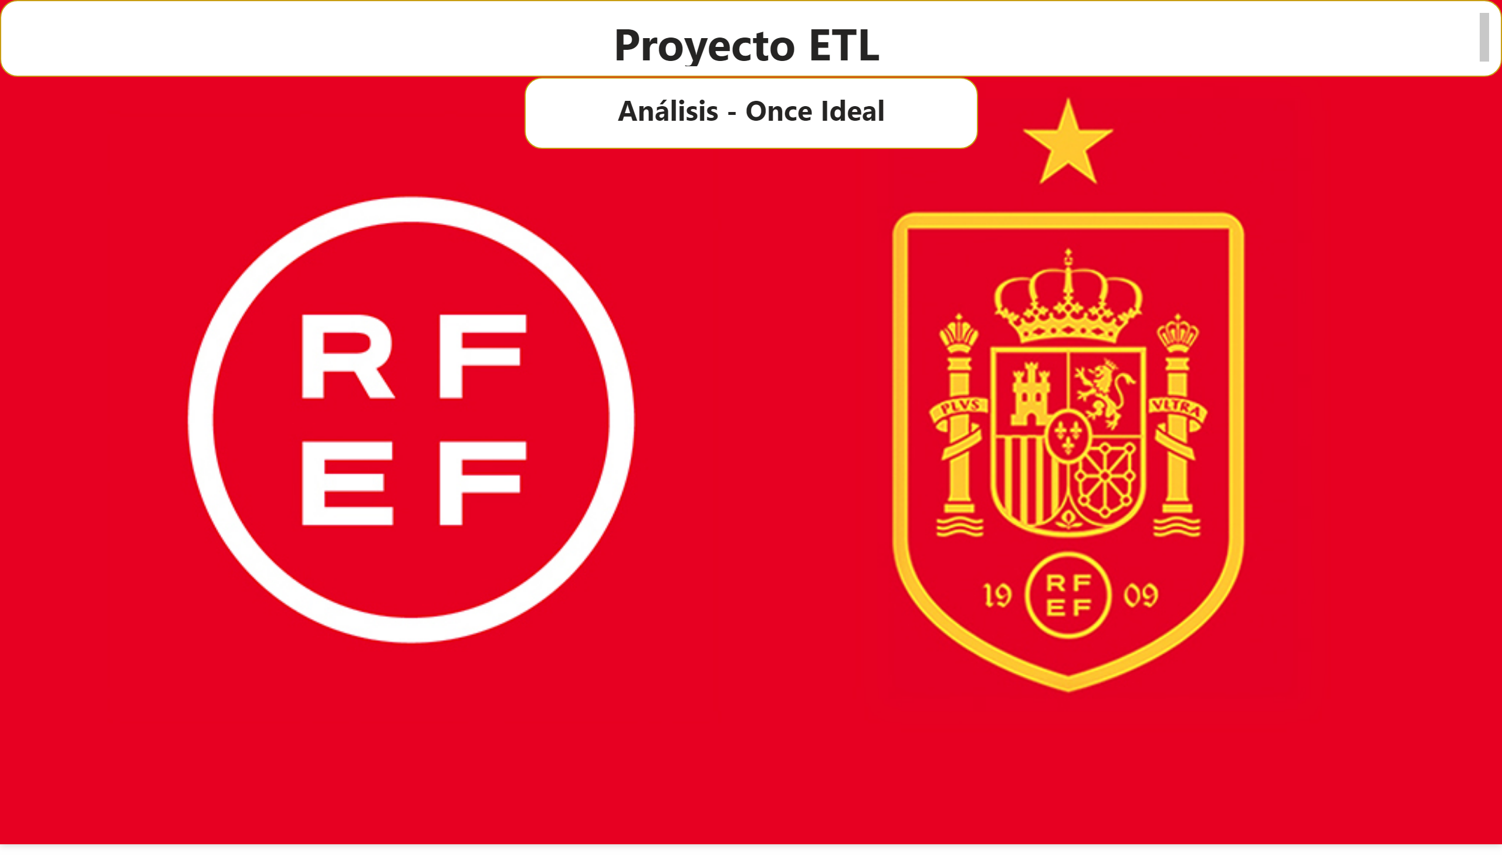
Portada
Notes:
textbox
No alt text provided.
textbox
No alt text provided.

Slide 2
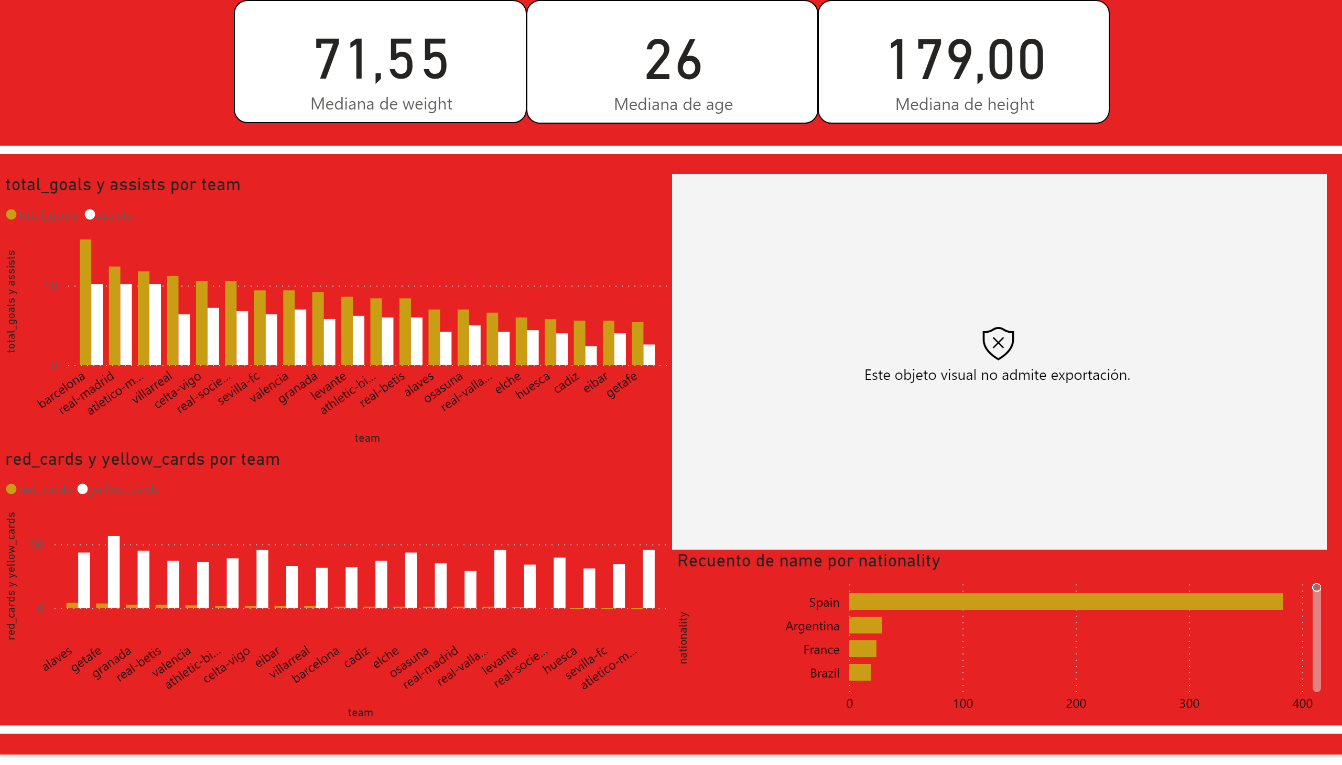
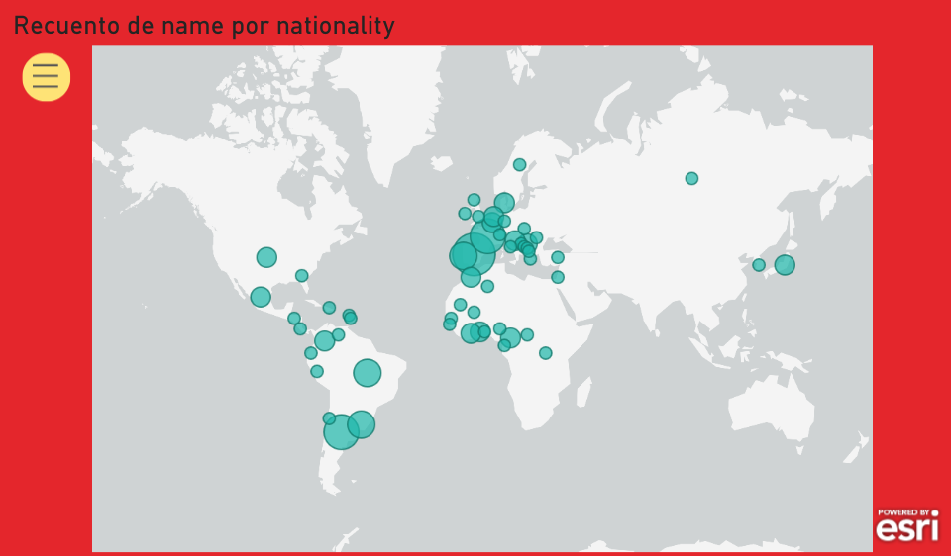
Resumen
Notes:
card
No alt text provided.
card
No alt text provided.
card
No alt text provided.
esriVisual
No alt text provided.
barChart
No alt text provided.
clusteredColumnChart
No alt text provided.
clusteredColumnChart
No alt text provided.
shape
No alt text provided.
shape
No alt text provided.

Slide 3
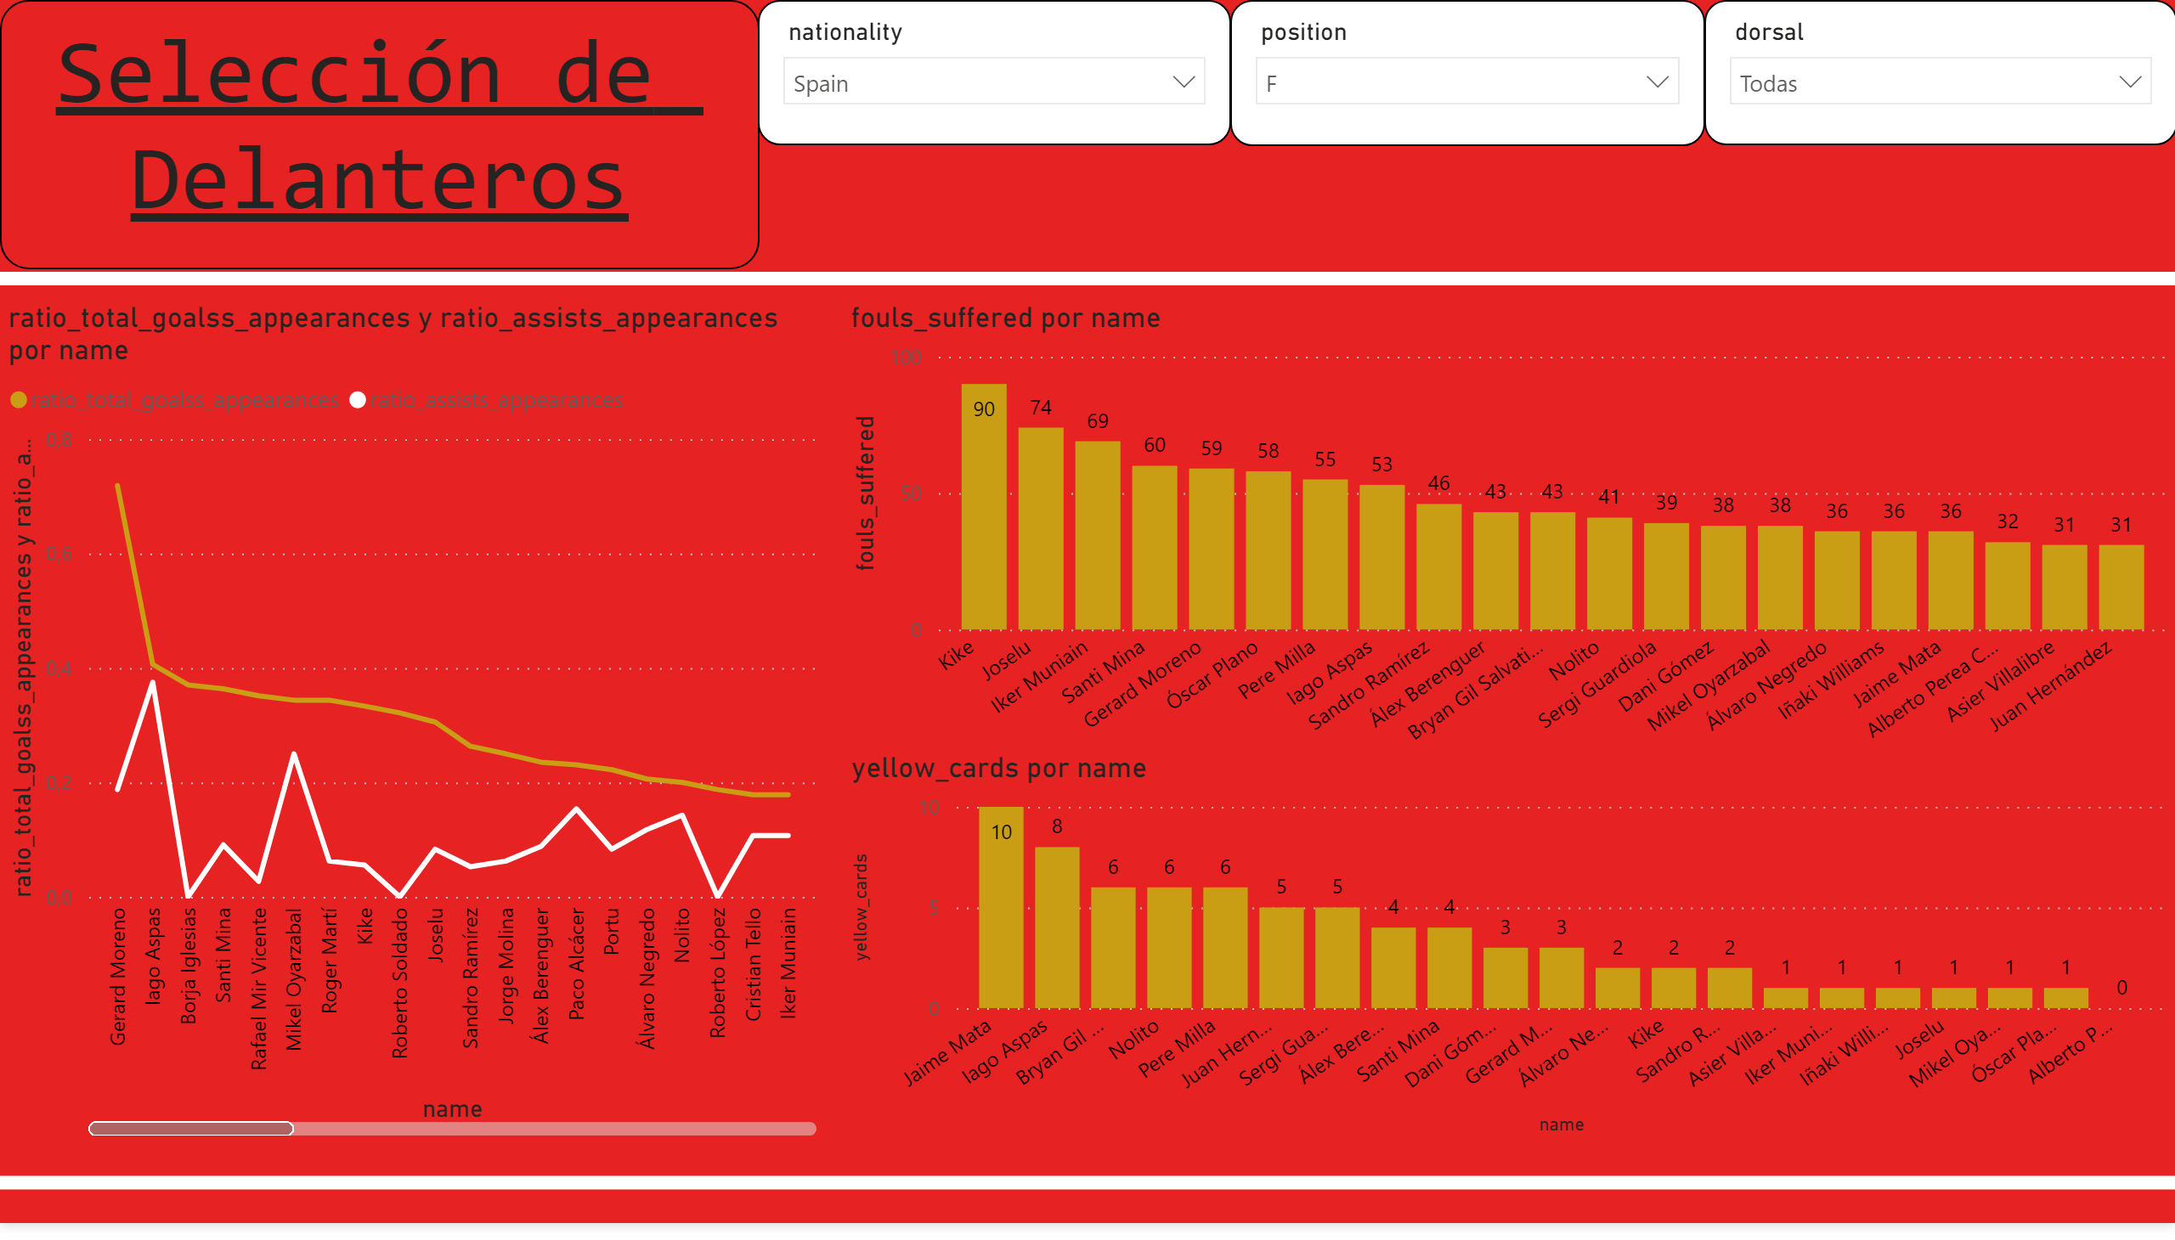
Delantero
Notes:
slicer
No alt text provided.
slicer
No alt text provided.
columnChart
No alt text provided.
columnChart
No alt text provided.
lineChart
No alt text provided.
slicer
No alt text provided.
shape
No alt text provided.
shape
No alt text provided.
textbox
No alt text provided.

Slide 4
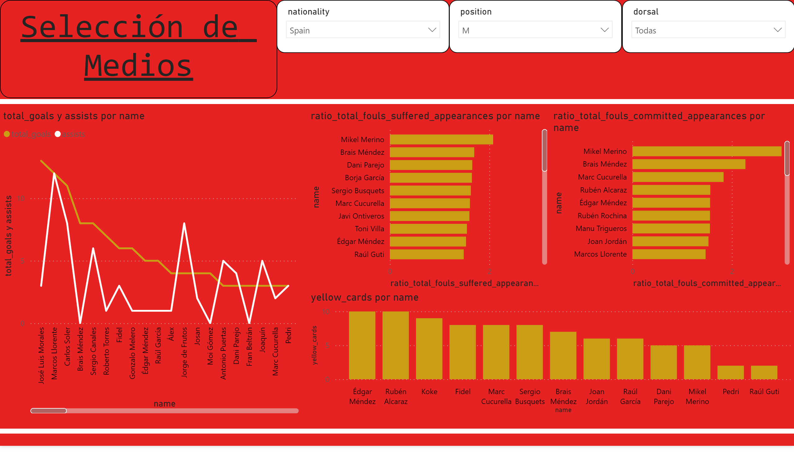
Medio
Notes:
slicer
No alt text provided.
clusteredBarChart
No alt text provided.
lineChart
No alt text provided.
columnChart
No alt text provided.
clusteredBarChart
No alt text provided.
slicer
No alt text provided.
slicer
No alt text provided.
shape
No alt text provided.
textbox
No alt text provided.
shape
No alt text provided.

Slide 5
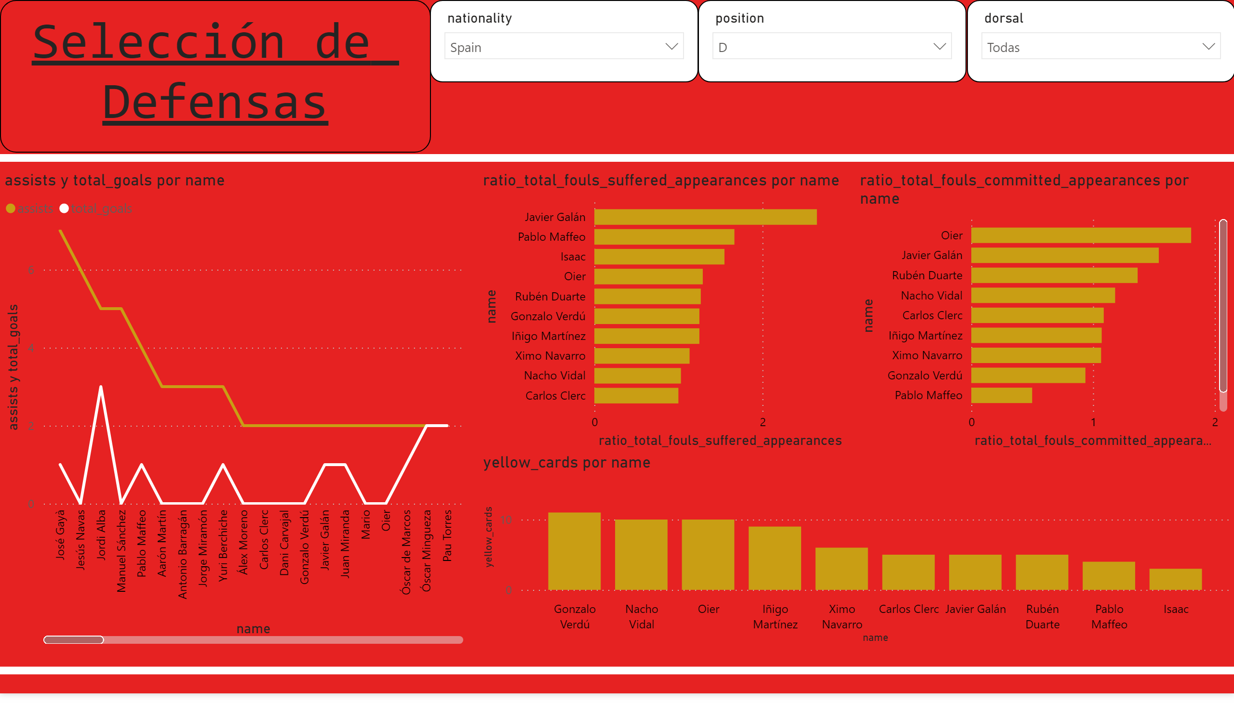
Defensa
Notes:
slicer
No alt text provided.
slicer
No alt text provided.
slicer
No alt text provided.
columnChart
No alt text provided.
clusteredBarChart
No alt text provided.
lineChart
No alt text provided.
clusteredBarChart
No alt text provided.
shape
No alt text provided.
textbox
No alt text provided.
shape
No alt text provided.

Slide 6
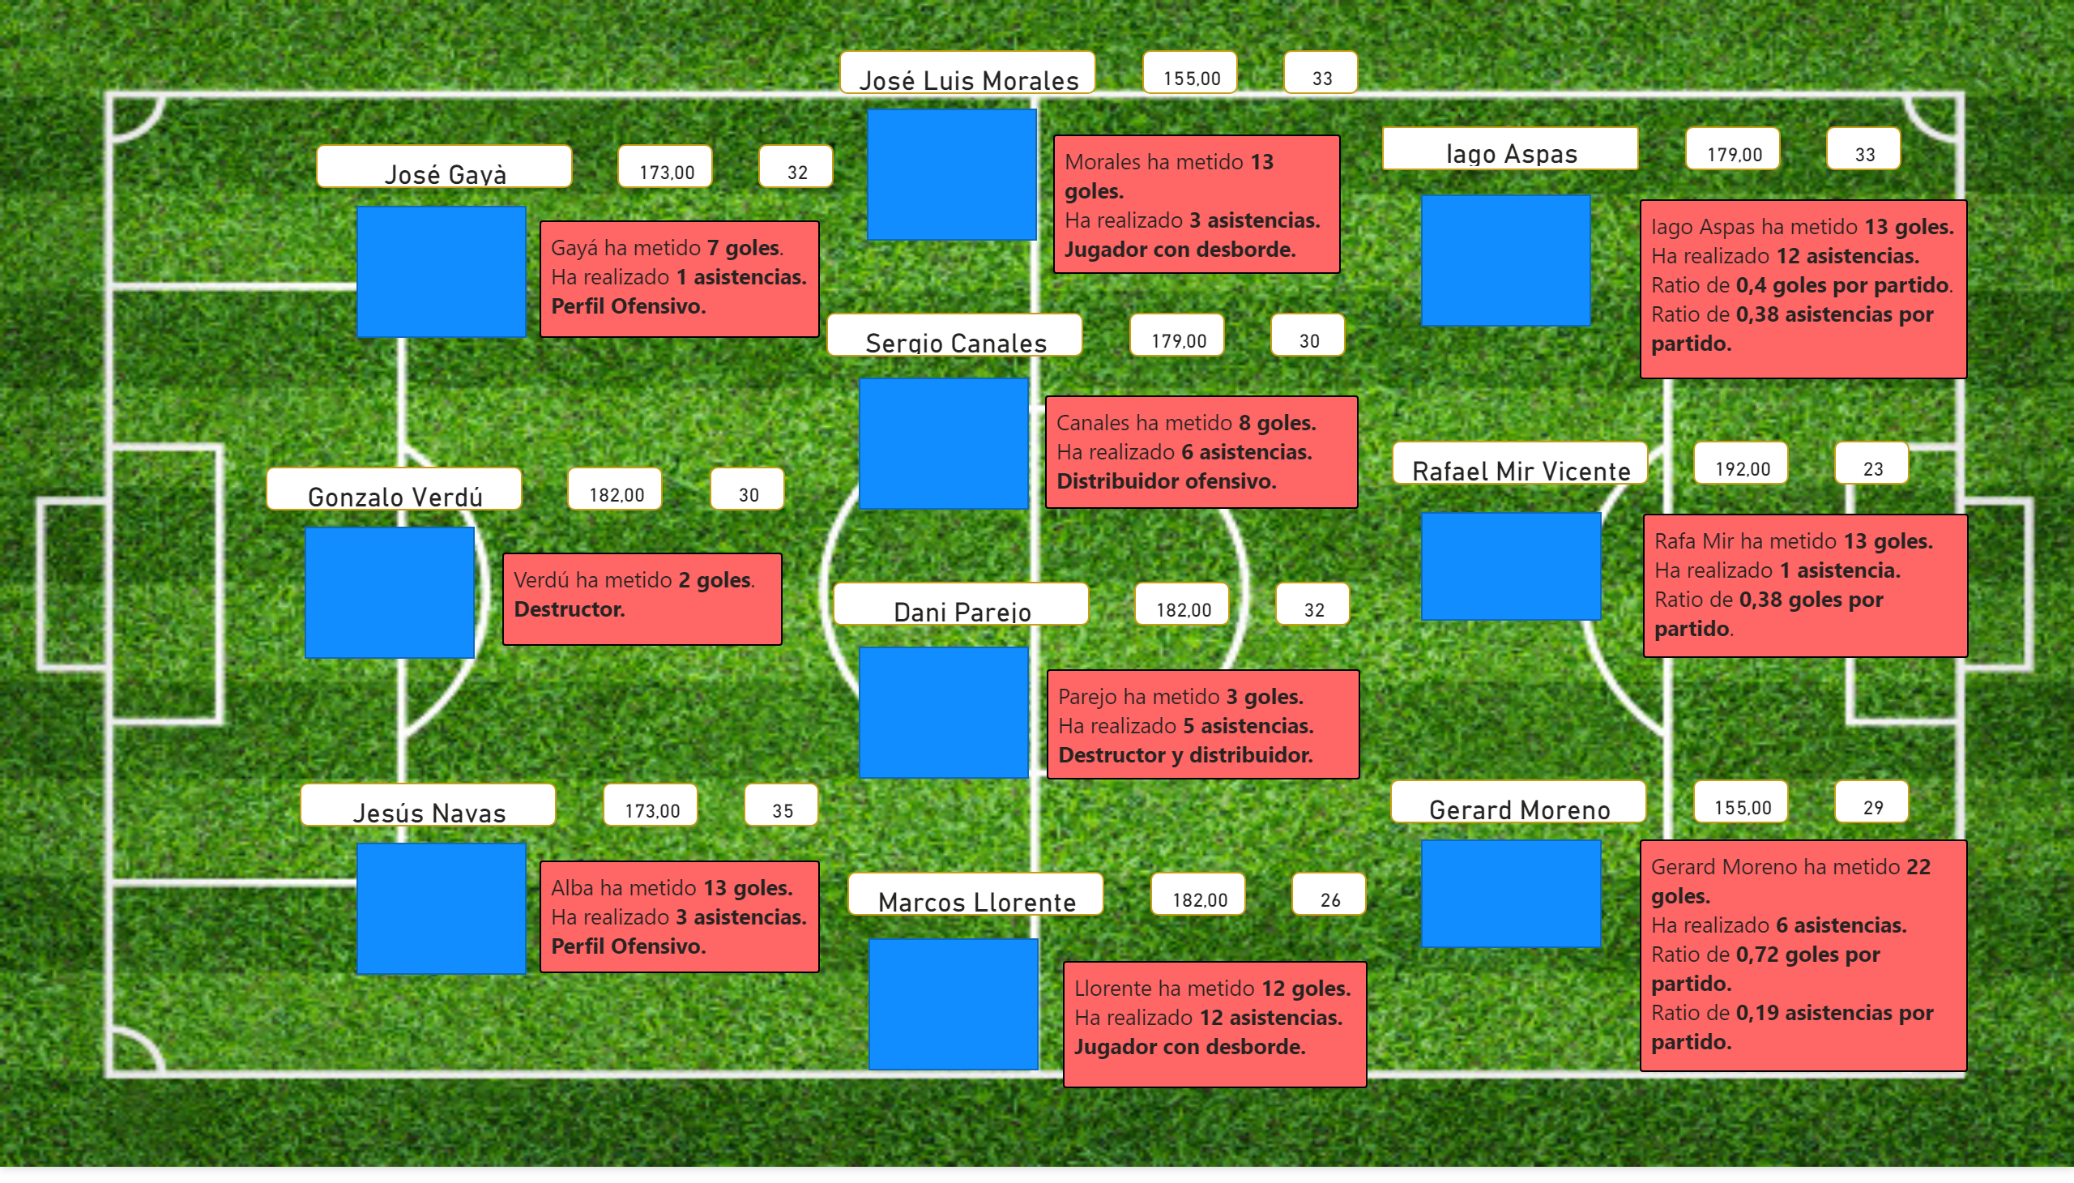


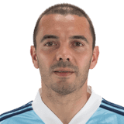



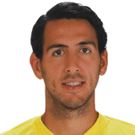

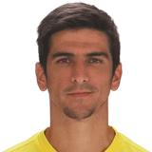

Once Ideal
Notes:
card
No alt text provided.
card
No alt text provided.
shape
No alt text provided.
shape
No alt text provided.
shape
No alt text provided.
card
No alt text provided.
card
No alt text provided.
card
No alt text provided.
card
No alt text provided.
card
No alt text provided.
card
No alt text provided.
card
No alt text provided.
card
No alt text provided.
card
No alt text provided.
card
No alt text provided.
card
No alt text provided.
card
No alt text provided.
card
No alt text provided.
card
No alt text provided.
card
No alt text provided.
card
No alt text provided.
card
No alt text provided.
card
No alt text provided.
card
No alt text provided.
card
No alt text provided.
card
No alt text provided.
card
No alt text provided.
card
No alt text provided.
card
No alt text provided.
card
No alt text provided.
card
No alt text provided.
card
No alt text provided.
shape
No alt text provided.
shape
No alt text provided.
shape
No alt text provided.
shape
No alt text provided.
shape
No alt text provided.
shape
No alt text provided.
shape
No alt text provided.
card
No alt text provided.
textbox
No alt text provided.
textbox
No alt text provided.
textbox
No alt text provided.
textbox
No alt text provided.
textbox
No alt text provided.
textbox
No alt text provided.
textbox
No alt text provided.
textbox
No alt text provided.
textbox
No alt text provided.
textbox
No alt text provided.

